Slide 1

Tools & Processes to Optimise your Business
Érin Kennedy
19 Nov 2023

Slide 2

“…EHRs, EMRs, personal health record (PHR), medical practice management software (MPM), and many other healthcare data components collectively have the potential to improve the quality, service efficiency, and costs of healthcare along with the reduction of medical errors.”
- Dash et al, 2019
Notes:
Data management in healthcare is extremely important for multiple reasons. Electronic health records/electronic medical records.

Slide 3
Challenges for GP Management
Efficient data management in large quantities – Big Data
Reports; Without an effective data management system, compiling and visualising reports for meetings/audits can be a tedious task. Reports should effectively communicate knowledge to others
Compliance with Regulatory Bodies and Relevant Laws; Standards must be strictly adhered to for healthcare practices and meetings/reviews regularly held. Data analysis can help visualise and communicate problems and ensure compliance in relevant areas
Accurate Tax Billing; With accurate and efficient data analysis and management of patient invoices and billing history, a GP practice can ensure accuracy in invoices sent/paid for and guarantee accurate reimbursement amounts.
Notes:
Data Analysis can also help track and identify at risk patients and help monitor effective treatment plans. Effective resource allocation can also be promoted trough data analysis such as medication allocation or meeting scheduling.

Slide 4
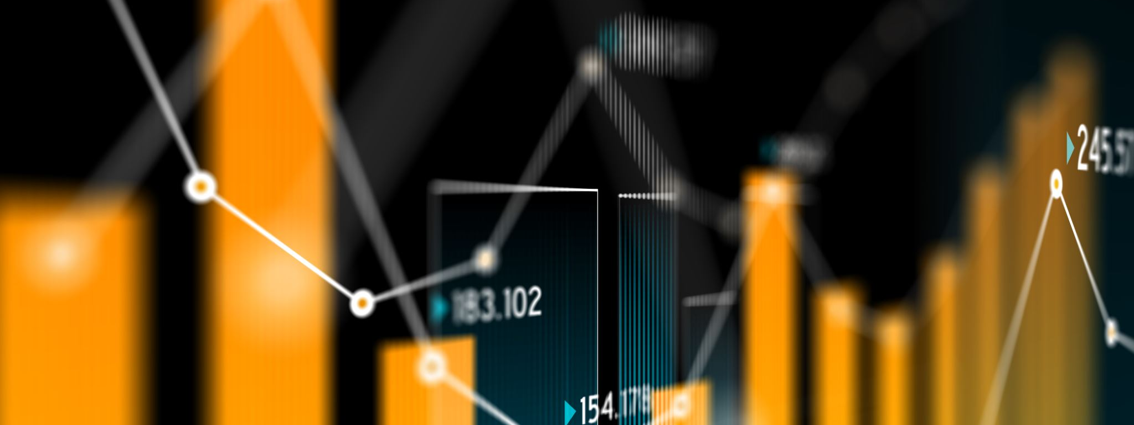
RStudio – An IDE for Statistical Computing & Data Analysis

Slide 5
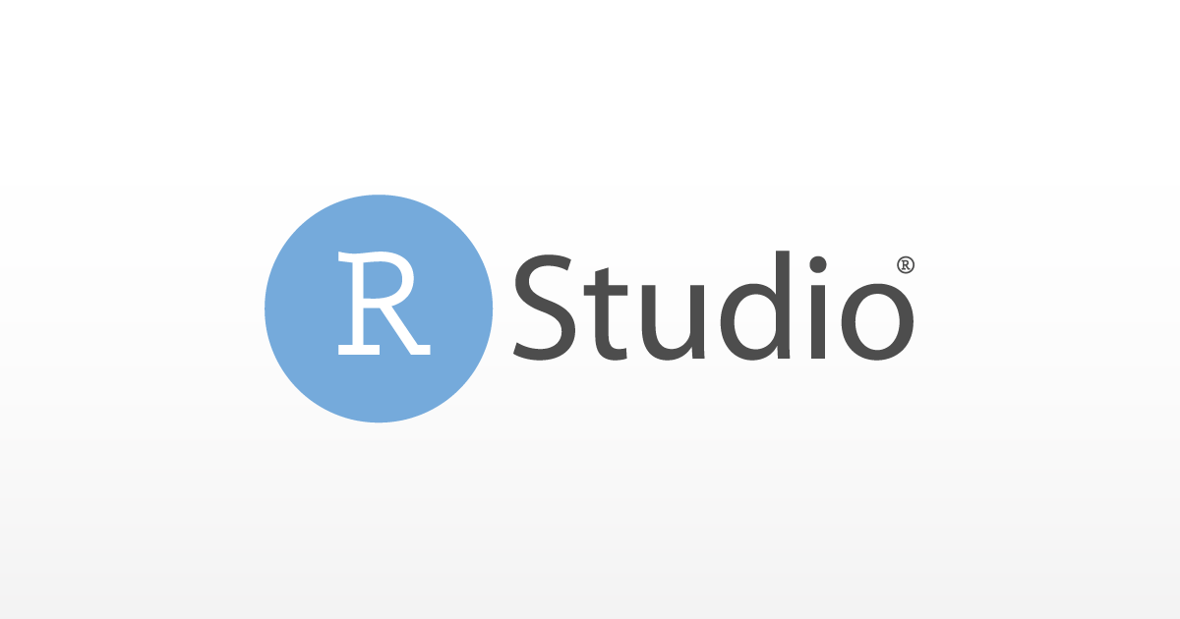
What is RStudio?
RStudio is a popular data analysis tool used in a wide range of industries, for example finance, government and retail.
Packages are installed to enable different functions within RStudio
A script file and console run independently to allow the user to work interactively and run and view Rcode results
“The most trusted IDE for open source data science”
– RStudio, 2023
Notes:
An IDE is an Integrated Development Environment. This is a platform that includes all of the basic tools required for programmers for maximum productivity. Rstudio uses the programming language R although it is compatible with other languages such as Java, C++ and Javascript. It was designed specifically for data analysis and other area such as visualisation of data and numerical analysis. Rstudio enables a variety of functions through the use of packages, each bringing a broader scope of abilities for the user.

Slide 6
Some popular packages
ggplot2 is a package that allows the user to visualise data and create graphs or charts.
Packages such as tidyr and dplyr allow data cleaning and analysis.

Slide 7

RStudio's Role in a GP
1. Big Data Management
RStudio can use its thousands of packages available to it to help a GP with its big data problems.
Data integration and cleaning can help ensure data quality and manage large datasets, especially where large memory storage may be a problem.

Slide 8
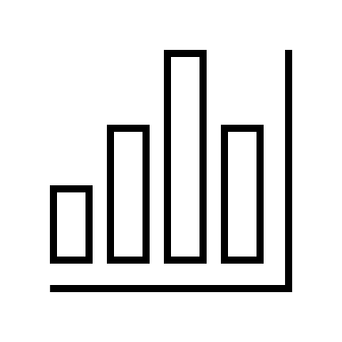

2. Visualisation
RStudio has many visualisation capabilities.
Using the popular package ggplot2, a user can create bar charts, line graphs and area plots.
Using an RMarkdown sheet, calculations and results can be explained and shown
Notes:
Shiny-interactive website creater.

Slide 9


3. Compliance with relevant laws
4. Accurate billing
RStudio can be a supportive tool regarding adherence to relevant laws and regulatory bodies regarding patient data, medication , etc. such as the General Medical Council and HSE*****
RStudio can be used to create a trail for audits and ensure compliance in data governance.
RStudio can also help manage and automate the data backup process to prevent data loss and improve upon secure file handling
RStudio can maintain an audit trail and create a transparent and accountable process reducing the likelihood of inaccuracies.
Quick custom reports can be created for patients with their tax history for insurance reasons, or for audit reports
Analysis can be made of patients history and information, showing trends in their payments and any missing information the GP may not have

Slide 10

Metabase - Business Intelligence, Dashboards, And Data Visualisation

Slide 11
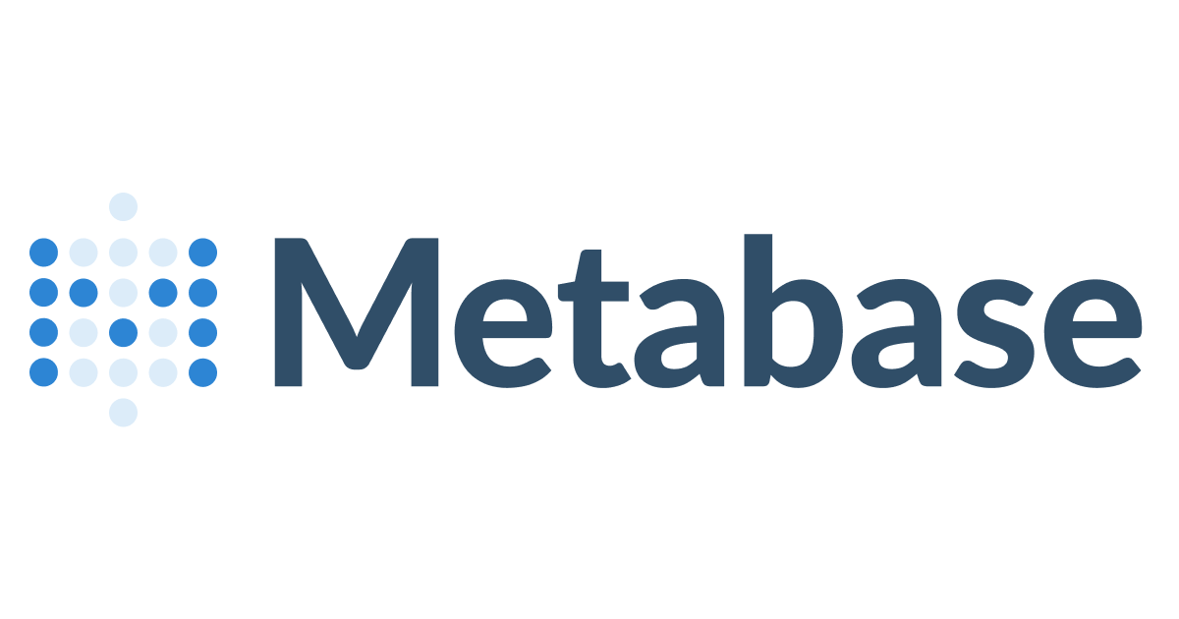
What is Metabase
Metabase is an open-source visualisation tool popular amongst non-coding experts and small businesses
Features of Metabase include;
Interactive dashboards and reports
Drag & drop/Drop-down user interface
Data Integration
“Fast analytics with the friendly UX and integrated tooling to let your company explore data on their own.”- Metabase, 2023
Notes:
Data integration from multiple sources such as

Slide 12

Metabase in GP Management
1. CUSTOM DASHBOARDS
Metabase can create versatile custom dashboards that can easily convey information for team-members.
Dashboards can be shared/exported to others for review providing a comprehensive view of the GP’s variables, for example patient billing information.

Slide 13


2. COMPLIANCE WITH RELEVANT LAWS
3. BILLING OPTIMISATION
Reports can be generated to remain in compliance with healthcare guidelines and regulations. These reports can be used for audits and to create a paper trail for information.
Optimisation methods can be introduced into billing methods. Patient billing and GP revenue data can provide insights into trends to allow better management of upcoming appointments. A reduction in patient-walkouts can also be identified as receptionists learn to identify trends.

Slide 14

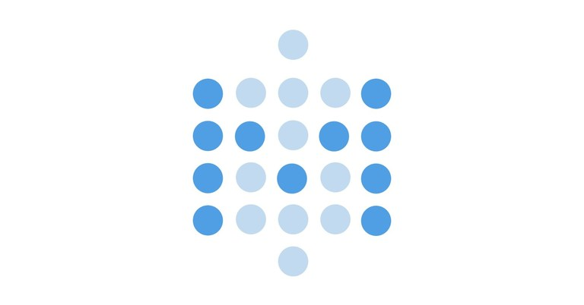
Comparison View
A powerful statistical data analysis tool with easy applicability to day-to-day problems
Requires expertise and knowledge to operate
GP applications; conducting research, analysing patient data, and making data-driven decisions based on clinical and operational data.
A simple data visualisation tool with a short learning curve for beginners in coding
Suitable for beginners with no coding background
GP Applications; presenting patient insight statistics, GP practice performance, and resource data, invoice data-based dashboards for audits
Notes:
For example, presenting the GP performance in a visual way or alternatively using Rstudio to conduct medical research through statistical analysis of health records.

Slide 15

Thank you for listening!
Érin Kennedy
Interpretation of Data
A00275664
Master of Science in Data Analytics

Slide 16
References
R. Kumar, Exploratory Data Analysis using R & RStudio. 2021. doi: 10.13140/RG.2.2.24944.99843.
J. Verzani, Getting Started with RStudio. O’Reilly Media, Inc., 2011.
S. Dash, S. K. Shakyawar, M. Sharma, and S. Kaushik, ‘Big data in healthcare: management, analysis and future prospects’, J Big Data, vol. 6, no. 1, p. 54, Jun. 2019, doi: 10.1186/s40537-019-0217-0.
B. Santos et al., ‘Open Source Business Intelligence Tools: Metabase and Redash’:, in Proceedings of the 11th International Joint Conference on Knowledge Discovery, Knowledge Engineering and Knowledge Management, Vienna, Austria: SCITEPRESS - Science and Technology Publications, 2019, pp. 467–474. doi: 10.5220/0008351704670474.
D. Jovanoska, R. Petrevska Nechkoska, and G. Mancheski, ‘Metabase Cockpits as a Base for BI in Strategic Management’, in Proceedings of the 26th International Scientific Conference Strategic Management and Decision Support Systems in Strategic Management, University of Novi Sad, Faculty of Economics in Subotica, 2021. doi: 10.46541/978-86-7233-397-8_116.

